Slide 1
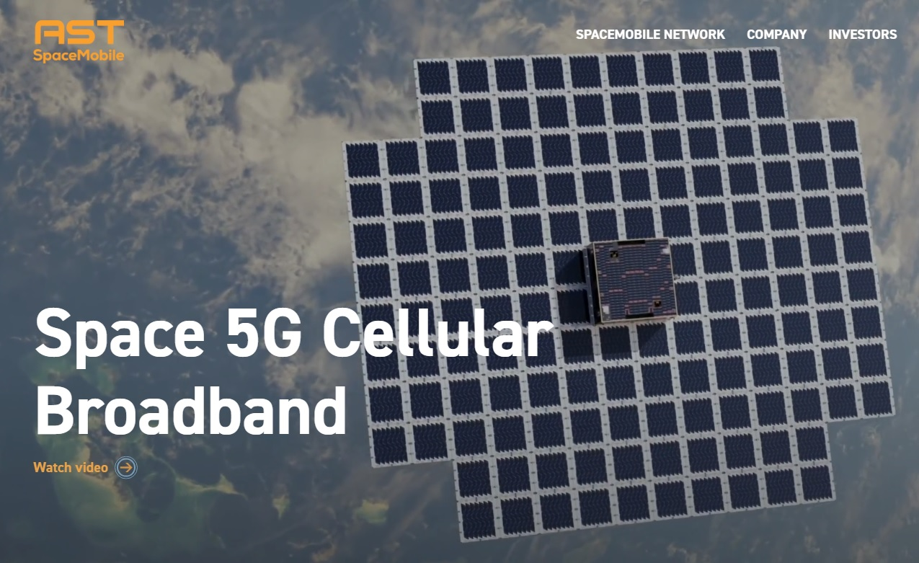
AST SpaceMobile

Slide 2
AST SpaceMobile
Mission statement:
To bring connectivity to areas with coverage gaps by building a space-based cellular broadband network.

Slide 3
AST SpaceMobile
Pros:
They have a service to sell
They are working on the service

Slide 4
AST SpaceMobile
Cons: Lots of competition
Starlink (2023 revenue: $4.2 B 46.61% increase over 2022)
ViaSat (2023 revenue: $3.79 B 31.67% increase over 2022)
NBN Sky Muster
TeleSat
SES S. A.
OneWeb
Telstra
Project Kuiper
EchoStar Mobile
Hughes Network System
Inmarsat (2023 revenue: $1.3 B 12% increase over 2022)

Slide 5
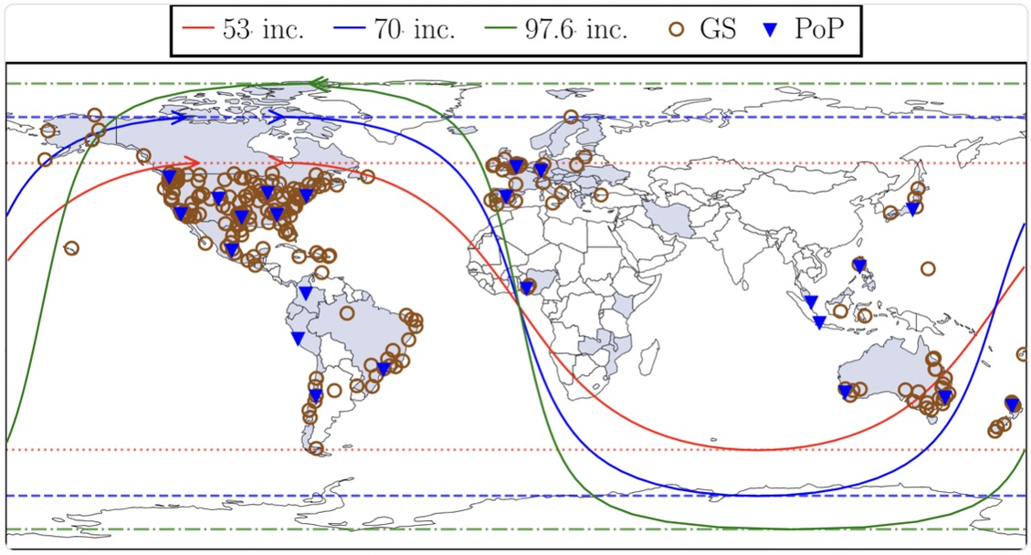
Cons: No ground operations

Slide 6
Starlink AST SpaceMobile
Proven Company (2018) Special Purpose Acquisition Co.
6,000 satellites in orbit 5 in orbit, 17 in works, 168 total
V1 satellites cost $200,000 ea. V1 satellites cost $16 million ea.
Cust: Airlines, Cruises, Military Cust: none
$6.6 B projected revenue $0 revenue. $352 Mil equip cost
220 Mbps bandwidth 10 Mbps bandwidth
Owns ground stations, PoPs Leases from Nokia
Sat. 63 times closer to earth Sat. 22,000 miles above earth
Latency 25 ms Latency 450 - 700 ms
5G, Enterprise net, MPLS 4G (testing 5G)
SpaceX multi-satellite launch SpaceX single-satellite launch
Successful On path to failure

