Slide 1
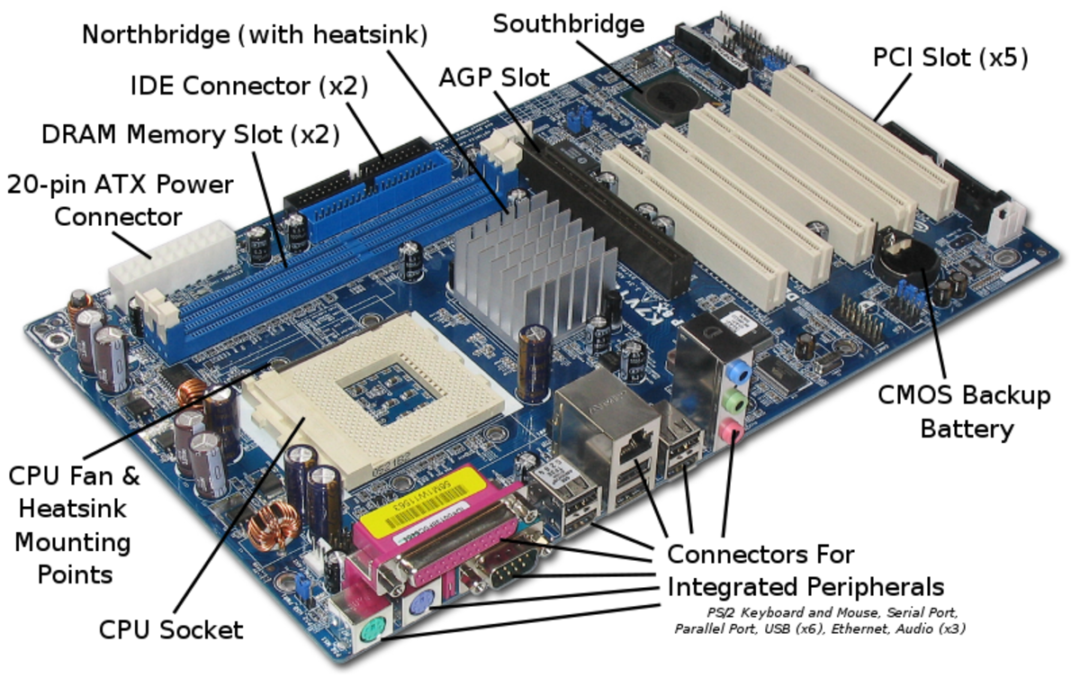
Computer Motherboard

Slide 2
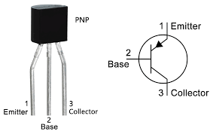
Transistors Create Bits
Varying the voltage on the base causes the transistor to act as a switch, turning a circuit on or off.

Slide 3
Transistors Create Bits
States: On = 1 Off = 0 Binary communication

Slide 4
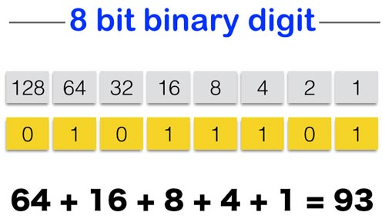
Binary Math

Slide 5
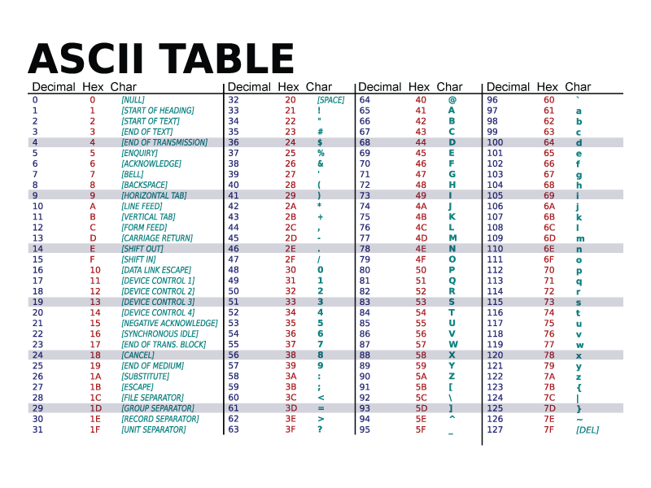
Text

Slide 6
Binary Text

Slide 7
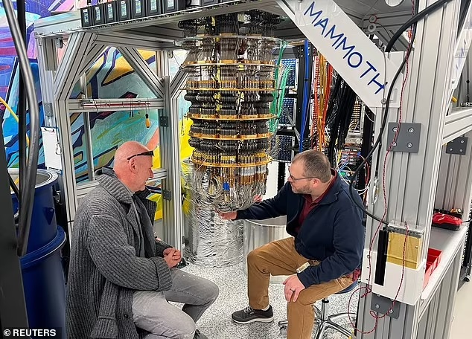
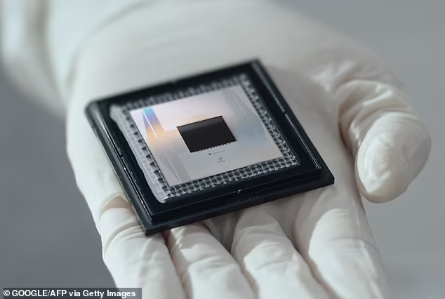
Meet “Willow”
A math problem that would have taken a super computer, one septillion years to solve, was solved by Willow in just five minutes. Septillion: 1 followed by 24 zeros.

Slide 8
Not Bits, Cold Qubits!
Superconducting qubits:
Superconducting materials operating at extremely low temperatures
Trapped ion qubits:
Trapped ion particles qubits enable high-fidelity measurements
Quantum dots:
Small semiconductors that capture a single electron and use it as a qubit
Photons:
Individual light particles used to send quantum information across long distances
Neutral atoms:
Neutral atoms charged with lasers provide scaling and fast operations

Slide 9

Outer Space
Ambient temp: -454.8 f A sea of entangled sub-atomic particles

Slide 10
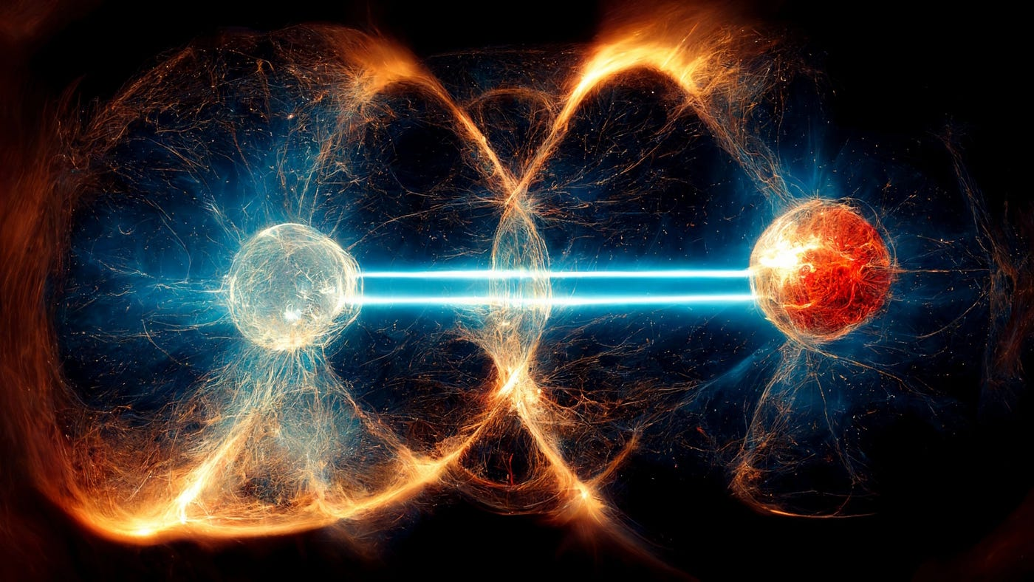
Quantum Entanglement
Sub atomic particles that interact can become inextricably linked

Slide 11
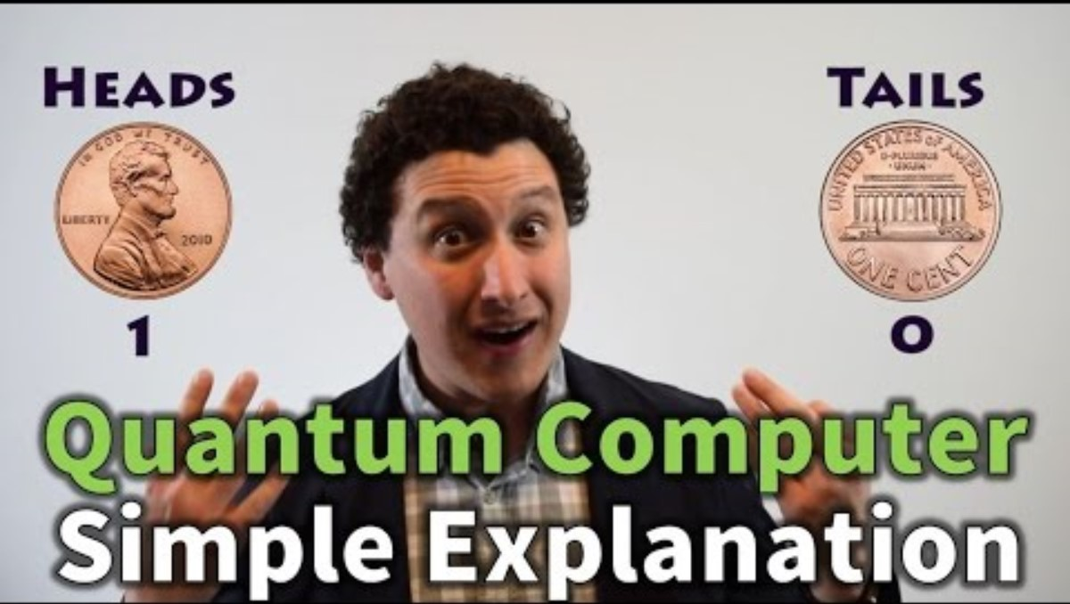

Slide 12
Ranked by Quant Rating
1. Quantum Computing (QUBT)
Strong Buy, 4.99 Market cap: $664.9M
Q3 2024 GAAP loss per share of 6 cents on revenue of $101K (+102% Y/Y)
2. Rigetti Computing (RGTI)
Strong Buy, 4.99 Market cap: $1.38B
Q3 2024 GAAP loss per share of 8 cents on revenue of $2.4M (-23.,4% Y/Y)
3. IonQ (IONQ)
Hold, 3.49 Market cap: $7.32B (already up 173% in 2024)
Q3 2024 GAAP loss per share of 24 cents on revenue of $12.4M (+102.1% Y/Y)
4. D-Wave Quantum (QBTS)
Hold, 3.48 Market cap: $901.3M
Q3 2024 GAAP loss per share of 11 cents on revenue of $1.9M (-27% Y/Y)
Companies: Google (GOOG), IBM (IBM), Microsoft (MSFT), Amazon (AMZN)
ETFs: VGT, XLK, IYW, FETC, IXN, RSPT

Slide 13
Leaders in AI
1. Serve Robotics (SERV)
Market cap: $663.59M
Raised $32.3 million in new capital in Q3 2024. Will partner with Uber Eats to deploy 2,000 robots by year-end 2025.
2. Sound Hound (SOUN)
Market cap: $6.87B
Secured a multimillion-dollar investment from Nvidia
Since November, stock has surged 217%
3. Palantir (PLTR)
Market cap: $166.76B (surged 300%% in 2024)
Q3 2024 GAAP loss per share of 24 cents on revenue of $12.4M (+102.1% Y/Y)
4. Synopsys (SNPS)
Market cap: $77.1B 15-year total return at 23.7%
Electronic design automation (EDA) software

Slide 14
Nuclear Power Providers
1. NuScale Power Corp (SMR) makes Small Modular Reactors
Market cap: $5.39B
44% of shares owned by other corporations
2. Oklo Inc (OKLO)
Market cap: $2.25B
Sam Altman (ChatGPT) backs this company and is a board member

Slide 15
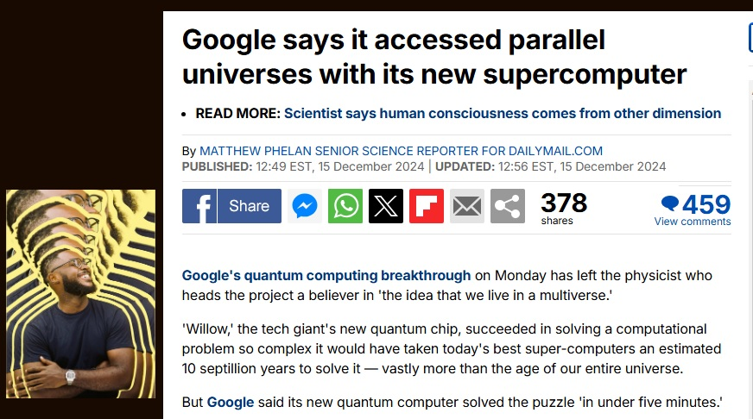
Parallel Universe?

Slide 16
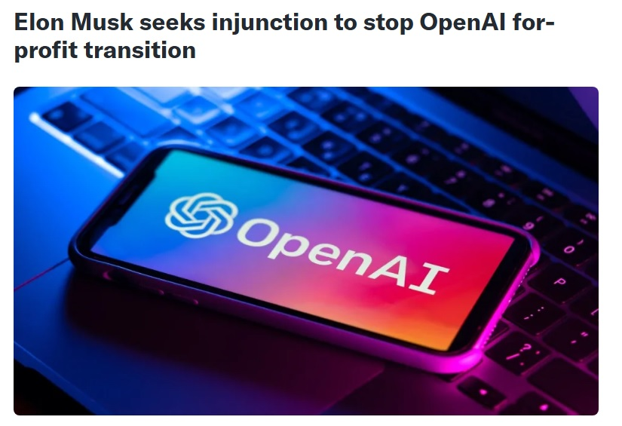
Elon Musk sues OpenAi
Alleges private AI development poses “existential danger”.

