Slide 1
2024 Stock Market Review
Jack Sherard

Slide 2
The stock market review for 2024
The S&P 500 returned 23%
The NASDAQ returned 28%
The equal weight S&P 500 returned 18%
Top performing stocks of the S&P 500
Palantir PLTR +349%
Vistra VST +263%
Nvidia NVDA +177%
United Air UAL +138%
GE Vernova GEV +135%
Axon AXON +133%
TX Pacific Land Corp TPL +111
Broadcom AVGO +111
169 stocks in the S&P 500 were down for the year
Only 150 made 23% or more

Slide 3
S&P Performance by Sector
Sector Major Holdings Symbol Return
Communication META, Netflix, Ebay XLC 34%
Consumer Discretionary Amazon, Tesla XLY 26%
Consumer Staples Costco, P&G, Walmart XLP 12%
Energy Chevron, Phillips XLE 5%
Health Lilly, J&J, UNH XLV 2%
Industrials Cat, GE Aerospace XLI 17%
Financials BRK, JPM, Visa XLF 31%
Materials Linde, SHW XLB 0%
Real Estate Prologic, AMT XLRE 5%
Technology Apple Nivida, Mic XLK 21%
Utilities NEE, Duke, Sou XLU 23%
S&P 500 SPY 23%
Tech 100 QQQ 28%
S&P 500 equal weight RSP 12%

Slide 4
Do your ETF's diversity your holdings?
The largest 5 EFT’s, their largest holdings and the total percentage invested in the magnificent 7
ETF Holdings by weight Percent
SPY Apple, Nvidia, Microsoft, Amazon, META, Tesla, Google 31%
IVV Apple, Nvidia, Microsoft, Amazon, META, Google, Tesla 29.9%
VOO Apple, Nvidia, Microsoft, Amazon, META, Google, Tesla 30%
VTI Apple, Nvidia, Microsoft, Amazon, META, Google, Tesla 25.59%
QQQ Apple, Nvidia, Microsoft, Amazon, META, AVGO, Tesla 44.1%

Slide 5
The Impact of AI Models and Agents

Slide 6
The 3rd year of AI LLMs
Likely to be the year of the buildout:
Capital expenditure estimates are Amazon 95B, MSFT 80B, GooG 51B, META 50B and TSLA 10B.
Much of the spend will go to NVDA

Slide 7
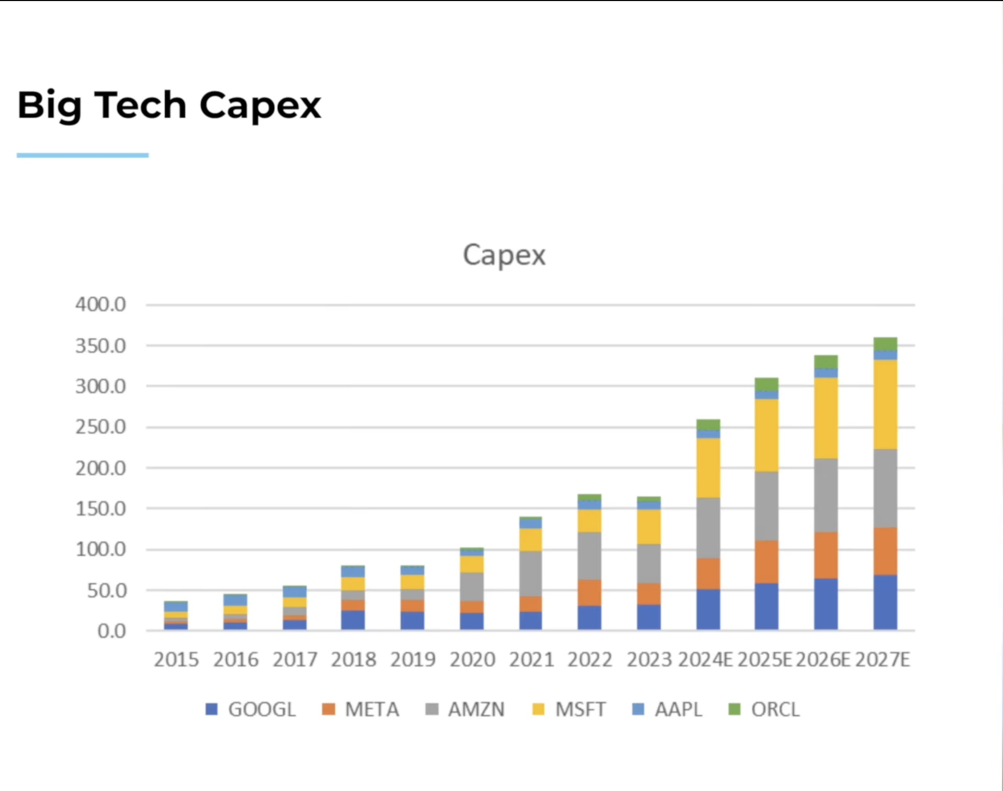

Slide 8
The 3rd year of AI LLMs
Spending on building LLM include AI Chat GBT, META, GOOG, other private co.'s.
Energy to run data centers: Vistra, Constellation, Talen, others? Cooling Vistra, VRT others
Application to individual businesses:
Will it be software companies Salesforce, Service Now, others, or agents like Palantir?
What is an agent?

Slide 9
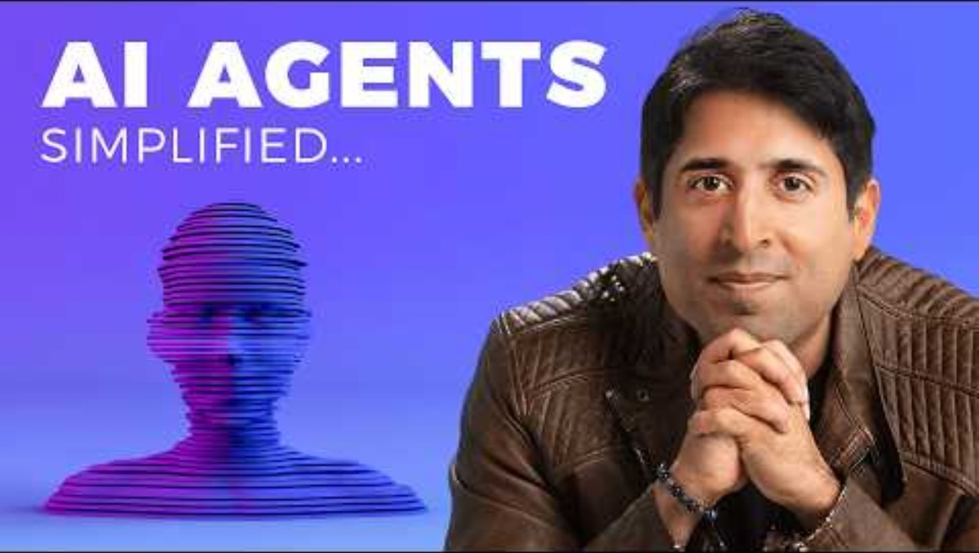

Slide 10
Companies already gaining from AI:
Amazon
Walmart
Netflix
Google
Salesforce
Meta
IBM
Baidu
Tesla
Alibaba

